Slide 1
MSc CGE – MathsGfx1 – Coursework2: Building Generation with 3D L-System
Team: Wanganning Wu, Madina Berkaliyeva

Slide 2
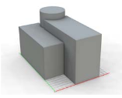
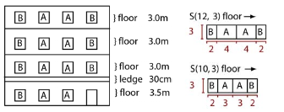
Introduction
L-System is a parallel rewriting system that can be used for procedural buildings generation.
There are several ways to generate buildings procedurally using L-Systems:
Generate the building mass using volumes (operators: insertion, transformation, branching);
Use meshes that represent walls as the base shapes (Houdini FX);

Slide 3
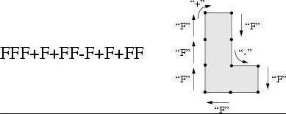
Implementing Walls
Instead of generating a line segment like how it does in using 2D L-System to draw a tree, it generates a rectangle surface
Connect the end point and the starting point and create a wall in between

Slide 4
Implementing Floor : Extension
P’
p
p

Slide 5
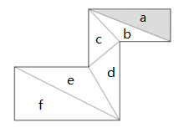
Implementing Floor
Since the floor may have a concave shape, we need to triangulate it.
One way to triangulate a simple polygon, that has no holes, is called Ear-Clipping algorithm.
The algorithm then consists of finding
such an ear, removing it from the polygon
(which results in a new polygon that still
meets the conditions) and repeating
until there is only one triangle left.

Slide 6
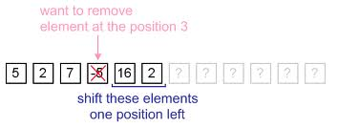
Doubly-linked and Circular List
-5
7
16
7
16
2
2
2
2
5
5

Slide 7
Implementing Windows
We extend the basic L-System rules, so now we can specify windows, window size and balconies:
K – place windows on the wall
(1.50) – set the size of the window to 1.50
B – place balcony on the wall
F+FK(1.50)K-FBK+FK(1.50)KFFK+FK(1.50)K

Slide 8
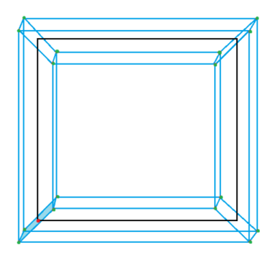
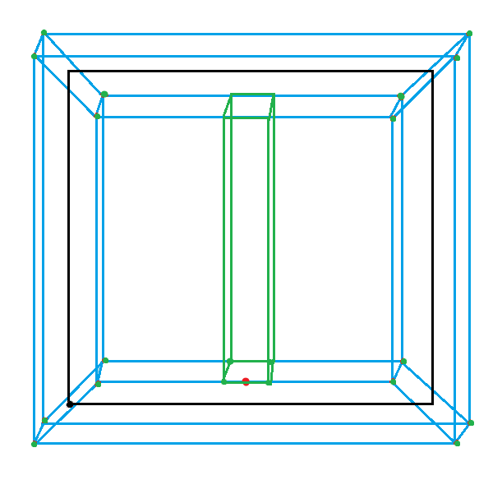
Implementing Frame and Balcony
Window frame
Balcony
1
3
Last wall
First wall
Current wall
2
Notes:
In order to build balcony in the correct direction, we need to find the outside direction of the building. For this we first find the cross product of the first and last wall, then we find the norm of the wall, then we need to find the cross product of the norm of the wall and one of its side. Then we compare the first cross product with this last cross product.

Slide 9
Conclusion
Next steps:
The next step would be adding more details to the building: various roofs, different window and balcony shapes, stairs and etc.
Making each floor of the building different from each other;
Applications:
Procedural City Generation
Architecture

Slide 10
Bibliography
2014. Procedural Modelling of Buildings [ONLINE] Available at: http://citeseerx.ist.psu.edu/viewdoc/download?rep=rep1&type=pdf&doi=10.1.1.112.183. [Accessed 6 January 2014];
PARISH, Y. I. H., M̈ULLER, P. 2001. Procedural modelling of cities. In Proceedings of ACM IGGRAPH 2001, ACM Press, E. Fiume, Ed.,301–308;
3Daet.com | L-system City . 2014. 3Daet.com | L-system City . [ONLINE] Available at: http://www.3daet.com/pages/805/l-system_city/. [Accessed 6 January 2014];
Polygon triangulation - Wikipedia, the free encyclopedia. 2014. Polygon triangulation - Wikipedia, the free encyclopedia. [ONLINE] Available at: http://en.wikipedia.org/wiki/Polygon_triangulation. [Accessed 5 January 2014];
Polygon Triangulation. 2014. Polygon Triangulation. [ONLINE] Available at: http://www.cs.unc.edu/~dm/CODE/GEM/chapter.html#FIG. [Accessed 5 January 2014];
2014. [ONLINE] Available at: http://www.cs.ucsb.edu/~suri/cs235/Triangulation.pdf. [Accessed 29 December 2013] ;
Polygon Partitioning. 2014. Polygon Partitioning. [ONLINE] Available at: http://www.personal.kent.edu/~rmuhamma/Compgeometry/MyCG/PolyPart/polyPartition.htm. [Accessed 5 January 2014].

